Slide 1
Team Trillion RikiPDYea
Team Leader: Biplov Ale
Developers :
Aryan Tandon
Gavin Singh
Lulseged Admasu

Slide 2
Introducing RikiPDYea
Purpose of RikiPDYea:
RikiPDYea is a dynamic, user-friendly application designed to offer wiki-like functionalities. It serves as a platform for users to create, edit, and share content in a collaborative environment.

Slide 3
Challenges in the Early Design of Riki
MongoDB Integration: Efficient data handling
Data Handling: Inefficient local storage led to management issues.
Search Inefficiency: Users couldn't search by author, limiting discoverability
Language Accessibility: Limited support for non-English speakers.
Visual Content: No image integration and management features.
Content Security: Risk of data loss due to no auto-save functionality.
User Security: Absence of user registration hindered access control.
Enhanced Search: Indexes, author-specific, and Regex searches.
One-Click Translation: Instant page translation for accessibility.
Image Management: Easy upload and download options.
Auto-Save Feature: Automatically saves edits and new pages
User Registration: Secure and managed user access.

Slide 4
Key Features of the RikiPDYea
MongoDB Integration: Efficient data handling
Customizable Profiles: Personalize user experience.
Enhanced Search: Indexes, author-specific, and Regex searches.
One-Click Translation: Instant page translation for accessibility.
Image Management: Easy upload and download options.
Auto-Save Feature: Automatically saves edits and new pages.
User Registration: Secure and managed user access.

Slide 5
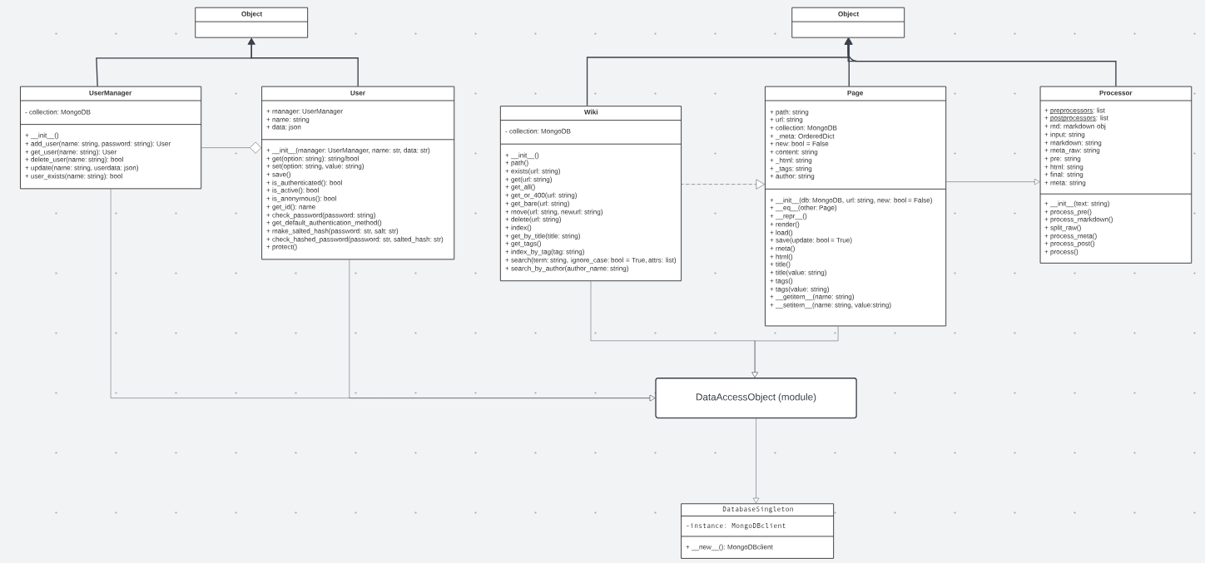
Improved Architecture of RikiPDYea

Slide 6
MongoDB Integration– Feature 1
Introduction:
Riki, our wiki-like app, initially stored data locally.
We upgraded to MongoDB in RikiPDYea
Technologies/Software used :
MongoDB and MongoDB Compass

Slide 7
MongoDB Integration – Feature 1
Challenges with original system:
Local storage:
→ Limited scalability.
→ Hindered real-time collaboration.
→ Increased risk of data loss.

Slide 8
MongoDB Integration – Feature 1
MongoDB Benefits:
Centralized Storage
→ Improved scalability.
→ Enabled real-time collaboration.
→ Enhanced data reliability.

Slide 9
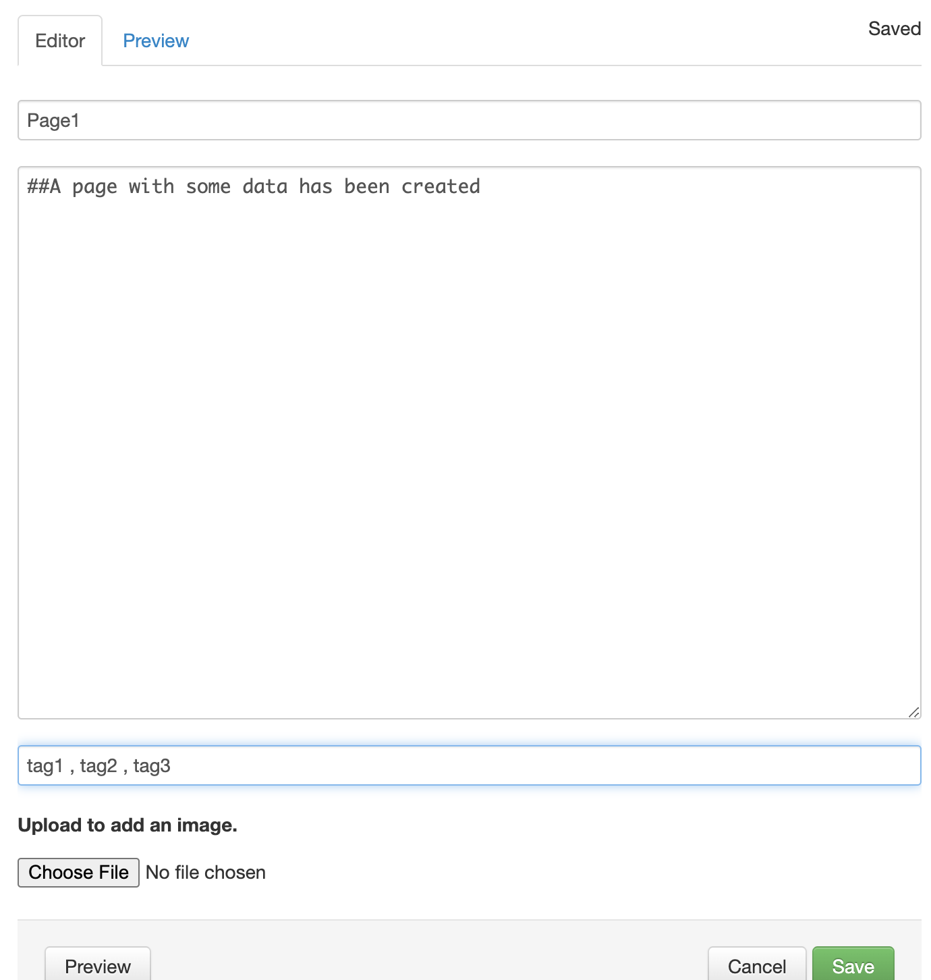
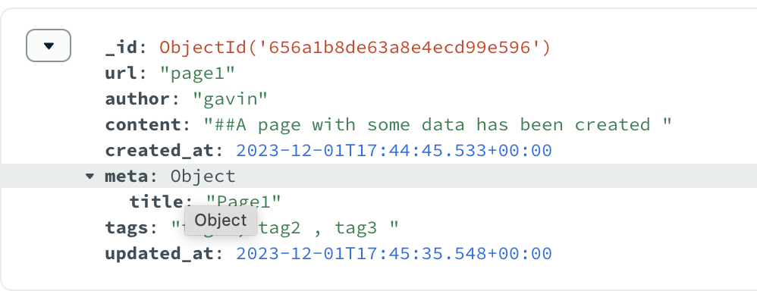
MongoDB Integration– Feature 1
Figure 1.2 Schema Design of MongoDB Database
Figure 1.1 Adding information in Editor

Slide 10
User Profile and Enhanced Functionality of Search – Feature 2
New Features:
→ Dedicated space for Biography.
→ Comprehensive list of user-created pages.
→ Search for all topics by using the author's name.

Slide 11
User Profile – Feature 2
Challenges with Original System:
Limitations:
→ No biography for self-introduction.
→ No way to get all the articles from an author

Slide 12
User Profile – Feature 2
Benefits of Updated Profile:
Advantages:
→ Biography enhances user engagement and networking.

Slide 13

User Profile – Feature 2
Use this to create user Biography
Figure 2.1 New users are required to set up a biography section

Slide 14
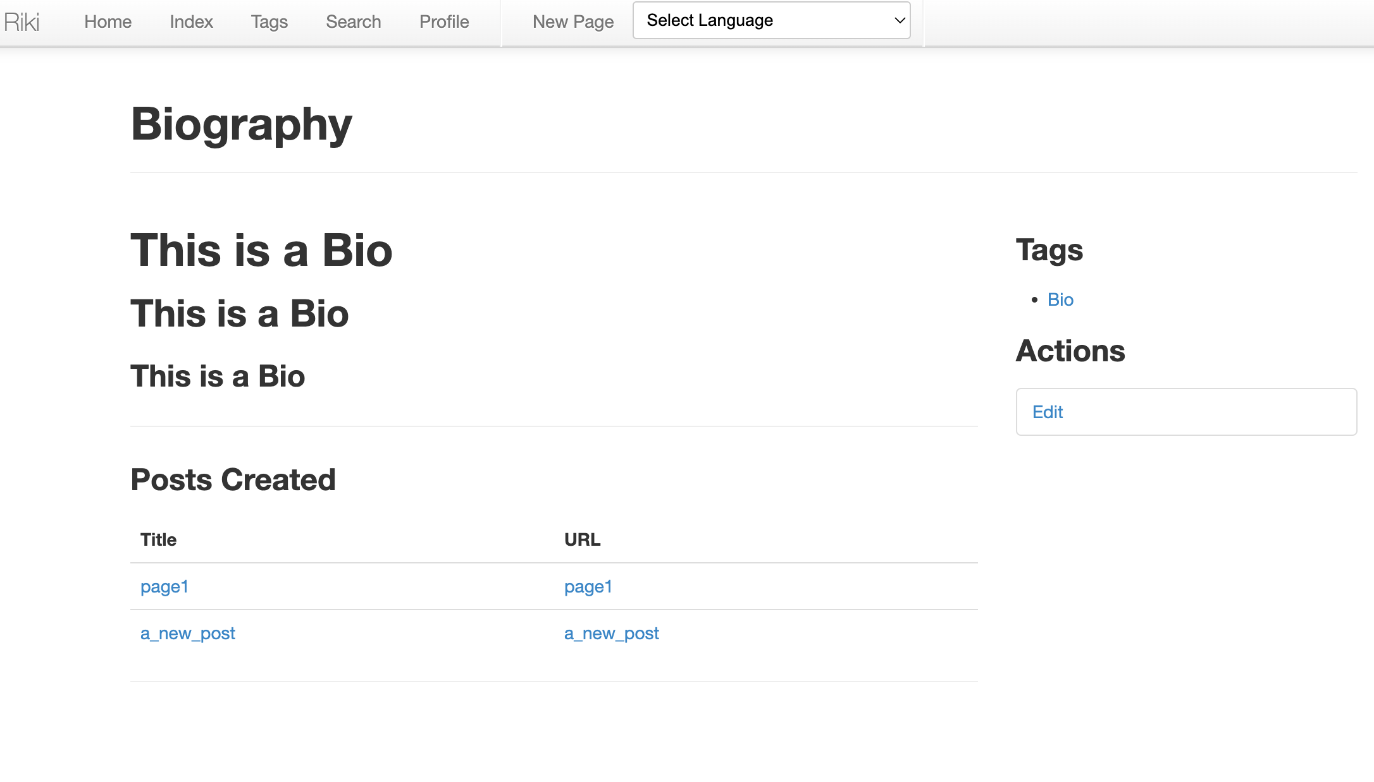
User Profile – Feature 2
Biography Section: The area designated for user Biography
Posts Created: Displays all user-generated posts
Figure 2.2 User Profile Section

Slide 15
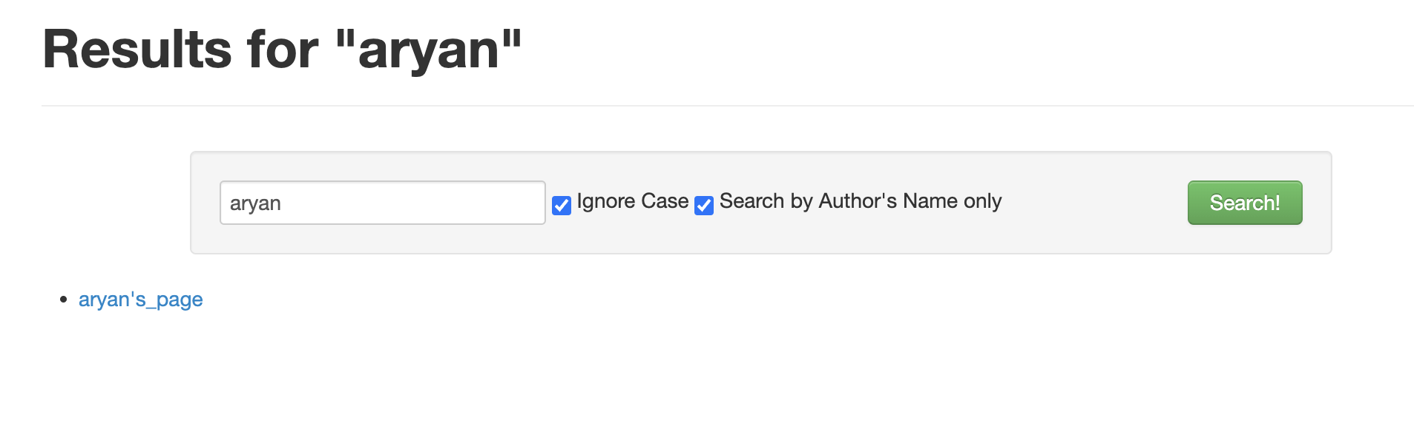
Enhanced Functionality of Search - Features 2
Figure 2.3 Search by Author’s Name is active

Slide 16
Enhanced Functionality of Search - Features 2
Page Editing Permissions:
General Pages:
→ Editable by all users to promote collaboration.

Slide 17
Testing - Feature 1 and 2
23-unit tests
11 in wiki.core.Page -> 11/11 for feature 1
12 in wiki.core.Wiki -> 11/12 for feature 1 and 1/12 for feature 2
Coverage
wiki.core.Page: 91%
wiki.core.Wiki: 95%

Slide 18
What “Gavin” learned
Developer: Gavin Singh
Practical Experience with Git Forks and Design Patterns
Proficiency in MongoDB Database Management.
In-Depth Understanding of the Software Development Life Cycle
Pioneering Team Communication Strategies
Collaborative Software Development

Slide 19
AutoSave and Prompt Save – Feature 3
Introduction:
→ Original: Save button manually triggers content saving.
→ Upgrade: Autosave every second during inactivity on edit page. Confirm exit feature on create page to prevent data loss.

Slide 20
AutoSave and Prompt Save – Feature 3
Challenges with Original System:
→ Issue: Risk of data loss due to accidental page exit.
→ Solution: Implementing autosave and confirm exit for efficient data preservation.

Slide 21
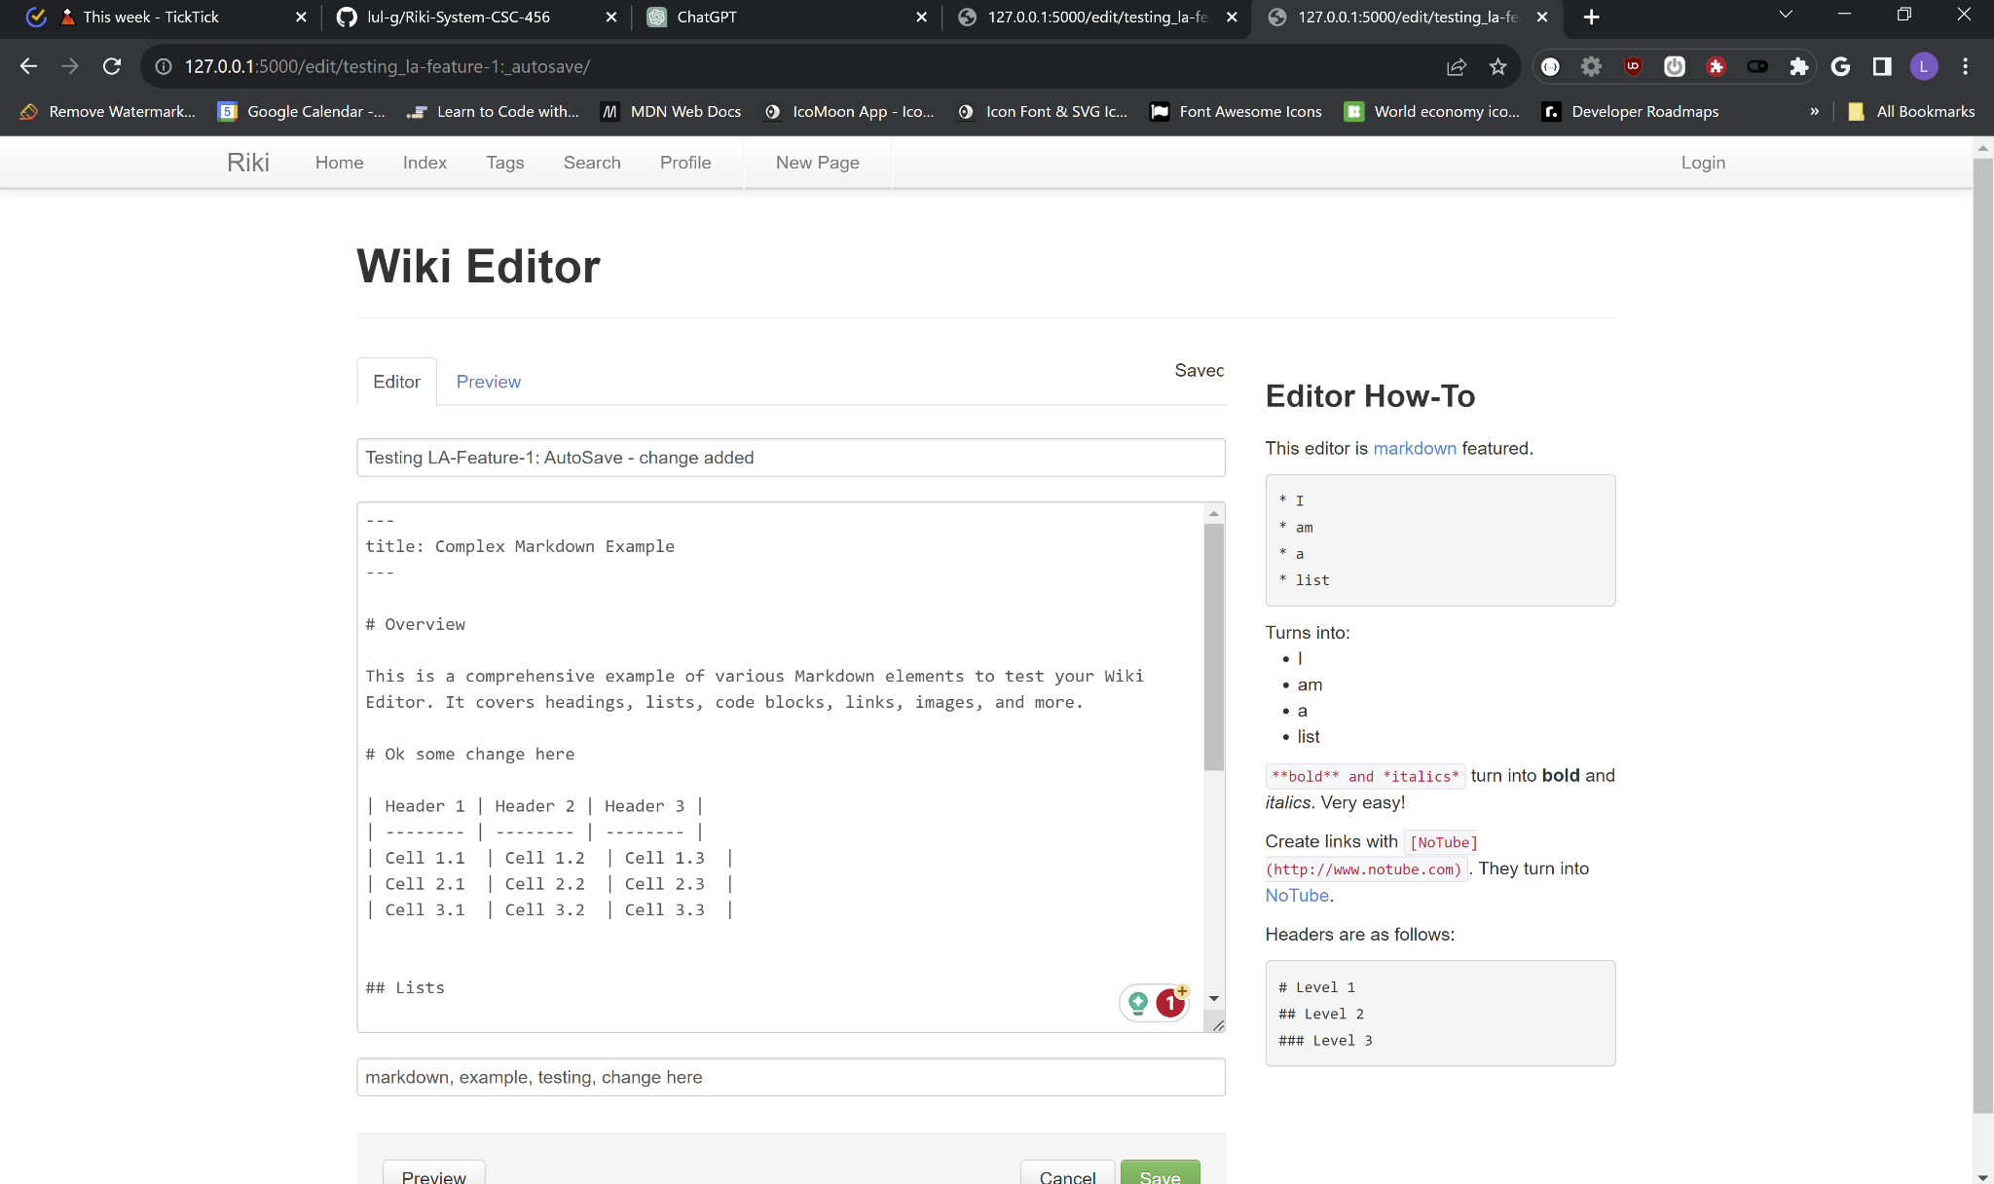
AutoSave and Prompt Save – Feature 3
Figure 4.1: Working of Auto-save Feature

Slide 22
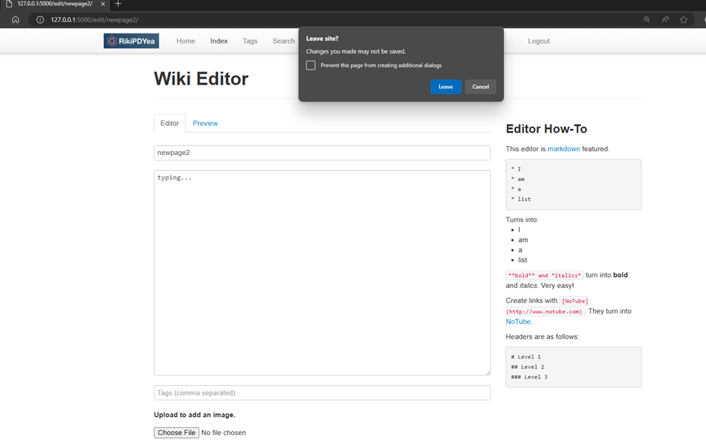
AutoSave and Prompt Save – Feature 3
Figure 3.2: Alert Asking for Confirmation to Save Changes Before Closing the Browser Window

Slide 23
Translate – Feature 4
Introduction:
→ Original: Content only in English, limiting user experience and accessibility.
→ Upgrade: One-click full-page translation, persists through refreshes and navigation.

Slide 24
Translate – Feature 4
Challenges with Original System:
→ Issue: Non-English speakers struggled with content comprehension.
Benefits of the Feature:
→ Outcome: Enhanced accessibility with multi-language support, improving user satisfaction.

Slide 25
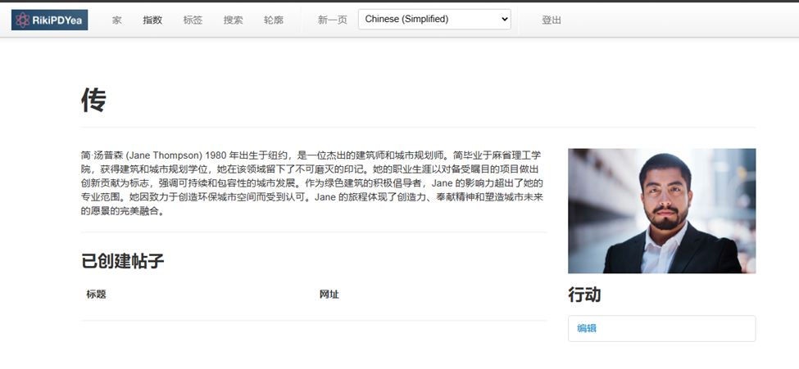
Translate – Feature 4
Figure 4.1: Working Of Translate Feature

Slide 26
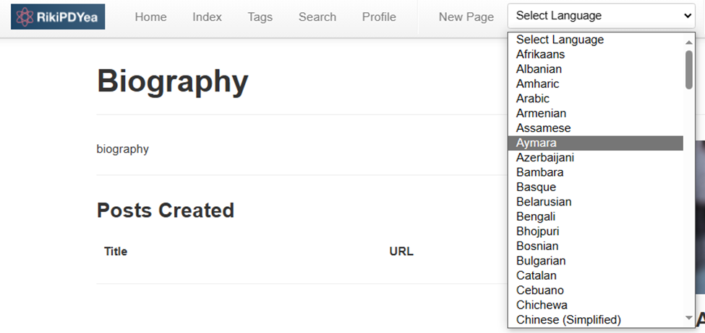
Translate – Feature 4
Figure 4.2: Choosing a Language for Page Translation

Slide 27
What “Lul” learned
Event Handling
DOM Manipulation
Asynchronous Requests
User Experience (UX) Design
Flask Backend Skills
GitHub & Translation Service
Notes:
Event Handling: Capture frontend events (e.g., button clicks, keyboard events).
DOM Manipulation: Utilize jQuery for dynamic DOM updates.
Asynchronous Requests: Make server requests asynchronously with AJAX.
User Experience (UX) Design: Design confirmation dialogs for improved UX.
Flask Backend Skills:
Define Flask routes for handling HTTP requests.
Access and process data using Flask's request object.
Understand RESTful API principles in Flask.
Send responses with appropriate status codes and data.
GitHub & Translation Service:
Utilize GitHub forks for collaboration and code contribution.
Attempt custom translator service; shift to Google Translate for simplicity.
Embrace the KISS (Keep It Simple, Stupid) principle.
Implement a quick, effective frontend translation solution.
Bypass extensive backend development through "Don't Build, Buy” philosophy.

Slide 28
User Registration - Feature 5
Introduction
Users can now register for access to the Riki System.
Benefits
Overcame the limitation of only allowing predefined accounts for sign-in.
Facilitates the expansion of the user base.
Promotes increased interaction with the Riki App.
Notes:
Introduction:
Users are able to register themselves so that they can access the Riki System.
Challenges with original system:
Users were only able to sign in using the predefined accounts. New Users wouldn’t be able to register to use the Riki App.
Benefits of the feature:
We are able to expand the user base. New users means more interaction for the Riki App.

Slide 29
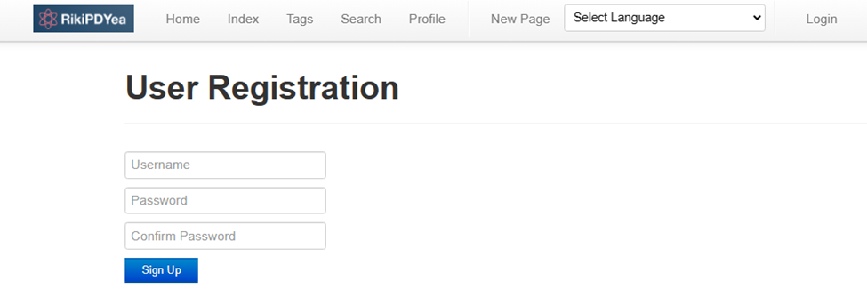
User Registration - Feature 5
Figure 5.1 User Registration page

Slide 30
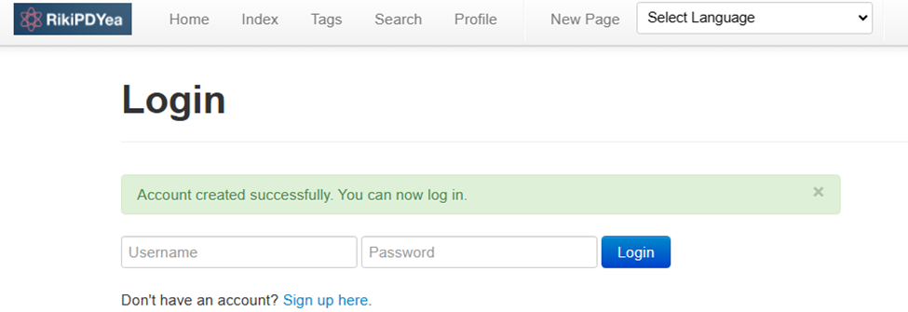
User Registration - Feature 5
Figure 5.2 : Following registration, users are directed to the Login page.

Slide 31
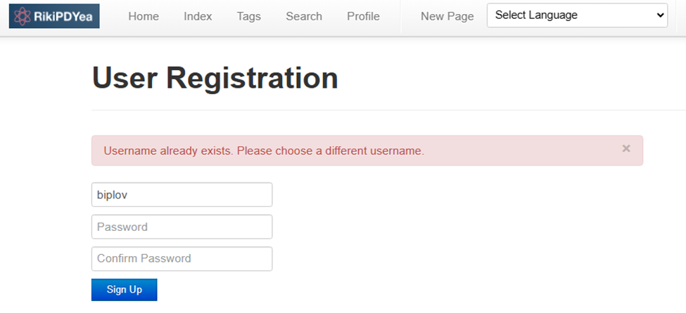
User Registration - Feature 5 Testing
-Validates Duplicate Usernames
Figure 5.3: Verification of Duplicate Usernames with Warning for Existing Ones

Slide 32
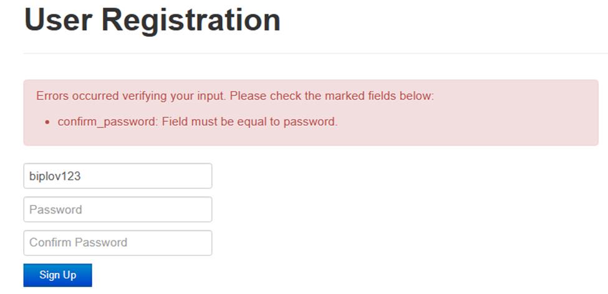
User Registration - Feature 5 Testing
-Validates Password and Confirm Password
Figure 5.4: Verification of password with Warning when passwords don’t match

Slide 33
Image Upload/Download - Feature 6
Introduction:
Riki Users can now upload/download images for Wiki Pages and Profiles, adding excitement.
Similar to a Book Cover, enhancing the visual appeal of the app.
Challenges:
Original system limited to text, reducing expressiveness.
Benefits:
Boosts engagement with visually appealing Riki pages.
Enables personalized profile sections with images.
Notes:
Introduction:
The Riki Users can now upload or download an image in their Wiki Pages and their Profiles making the app more exciting for the users. Think of it as a Cover Page for a Book.
Challenges with original system:
Users were only able to add texts previously making the Riki App less expressive.
Benefits of the feature:
With the addition of this feature it makes the Riki pages more engaging to the users.
Users can also personalize their profile sections with this feature.

Slide 34
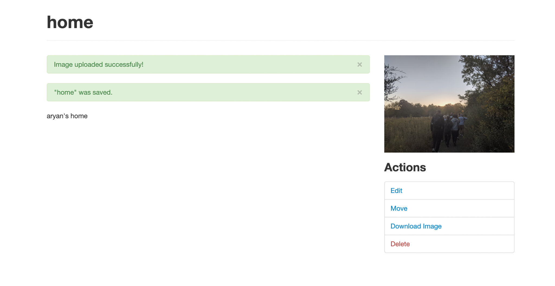
Image Upload/Download - Feature 6
Figure 6.1: Confirmation Prompt on Image Upload

Slide 35
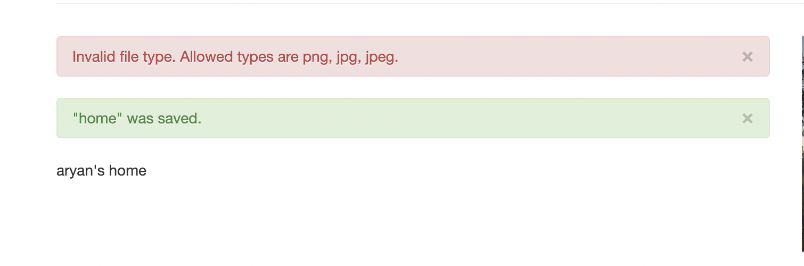
Image Upload/Download - Feature 6 Testing
-Validates file upload type (Only allows .png, .jpg, .jpeg)
Figure 6.2: Alert for Unsupported Image Format

Slide 36
What “Aryan” learned
Software Development Life Cycle
Knowledge of Python, Jinja and Flask.
Routing in Flask
Teamwork and Communication

Slide 37
Overall Project Summary
Total Requirements: 100% done (26 out of 26)
Test Requirements: 100% done (32 out of 32)
Integration testings: passed
Regression testings: passed
acceptance testings: passed

Slide 38
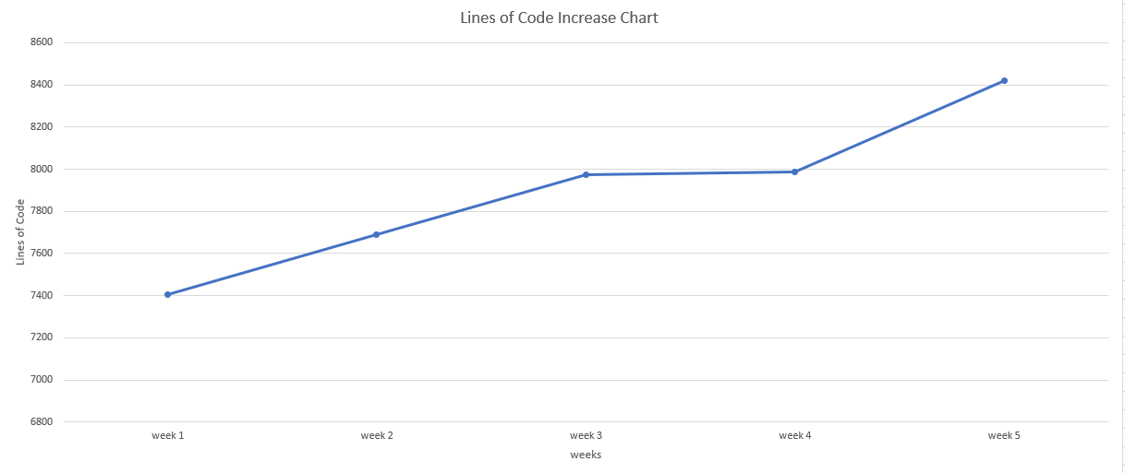
Overall Project Summary
Initial LoC: 7403 Final LoC: 8421

Slide 39
What “Biplov” learned?
Collaborative Software development
Integration, regression and acceptance testing.
Flask and Jinja
importance of software design
Complexities related Human Factors in a team

Slide 40
Questions/Comments

Slide 41
Thank You !

